Slide 1
Data Preprocessing
Data Cleaning, Data Integration, Data Reduction
&
Data Transformation

Slide 2
Data Quality
Measures for data quality:
There are many factors comprising data quality, including accuracy, completeness, consistency, timeliness, believability, and interpretability.
Accuracy: correct or wrong, accurate or not (i.e., having incorrect attribute values).
The data collection instruments used may be faulty. There may have been human or computer errors occurring at data entry.
Errors in data transmission can also occur--limited buffer size.
Duplicate tuples also require data cleaning.
Completeness: not recorded, unavailable, …
Attributes of interest may not always be available.
Data may not be included simply because they were not considered important at the time of entry.
Relevant data may not be recorded due to a misunderstanding or because of equipment malfunctions.

Slide 3
Data Quality
Measures for data quality:
There are many factors comprising data quality, including accuracy, completeness, consistency, timeliness, believability, and interpretability.
Consistency: some modified but some not, dangling, …
Data that were inconsistent with other recorded data may have been deleted.
Missing data, particularly for tuples with missing values for some attributes, may need to be inferred.
Timeliness: timely update?
The fact that the month-end data are not updated in a timely fashion has a negative impact on the data quality.
Believability: how trustable the data are correct?
How much the data are trusted by users.
Interpretability: how easily the data can be understood?

Slide 4
Major Tasks in Data Preprocessing
Data cleaning
Fill in missing values, smooth noisy data, identify or remove outliers, and resolve inconsistencies
Data integration
Integration of multiple databases, data cubes, or files
Data reduction
Dimensionality reduction
Numerosity reduction
Data compression
Data transformation and data discretization
Normalization
Concept hierarchy generation

Slide 5
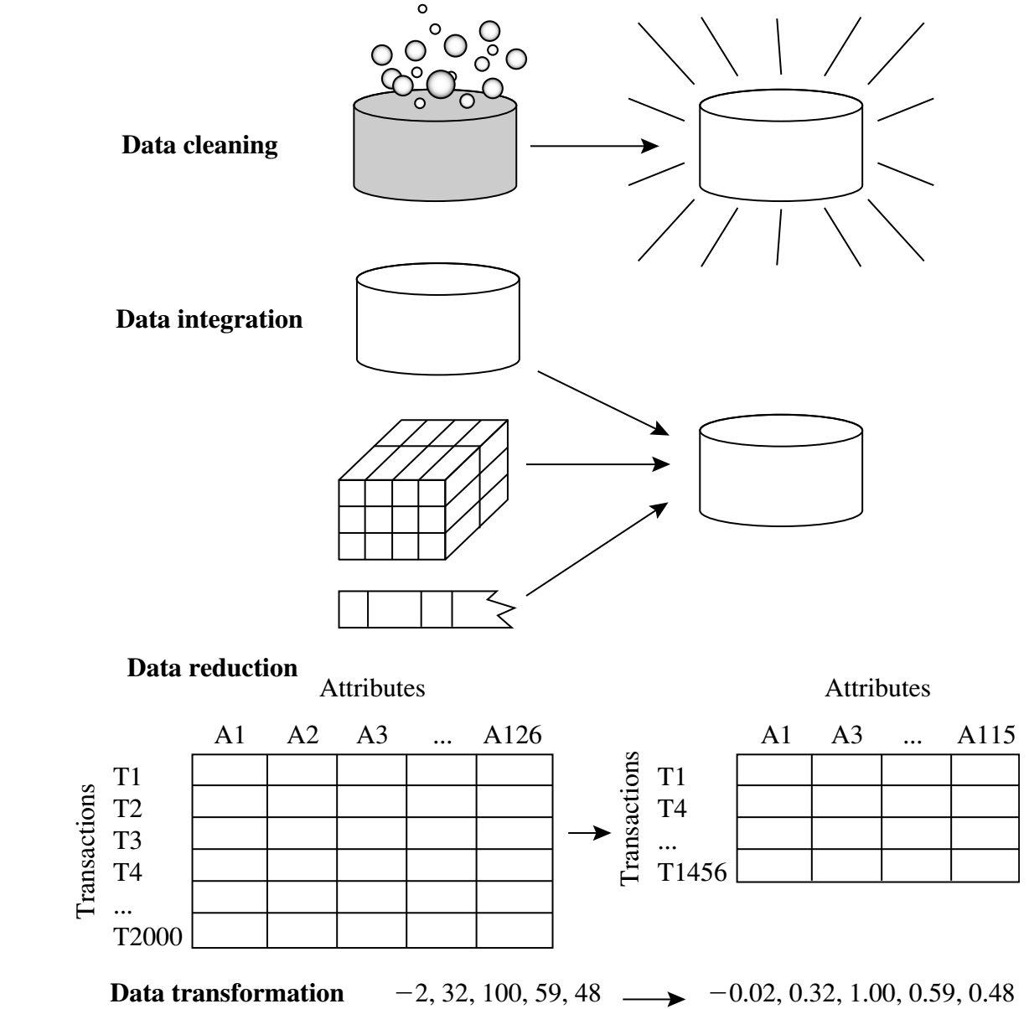
Major Tasks in Data Preprocessing
Data cleaning
Fill in missing values, smooth noisy data, identify or remove outliers, and resolve inconsistencies
Data integration
Integration of multiple databases, data cubes, or files
Data reduction
Dimensionality reduction
Numerosity reduction
Data compression
Data transformation and data discretization
Normalization
Concept hierarchy generation

Slide 6
1. Data cleaning
Data in the Real World Is Dirty: Lots of potentially incorrect data, e.g., instrument faulty, human or computer error, transmission error.
Incomplete: lacking attribute values, lacking certain attributes of interest, or containing only aggregate data
e.g., Occupation=“ ” (missing data)
Noisy: containing noise, errors, or outliers
e.g., Salary=“−10” (an error)
Inconsistent: containing discrepancies in codes or names, e.g.,
Age=“42”, Birthday=“03/07/2010”
Was rating “1, 2, 3”, now rating “A, B, C”
discrepancy between duplicate records
Intentional (e.g., disguised missing data)
Jan. 1 as everyone’s birthday?

Slide 7
A. Incomplete (Missing) Data
Data is not always available
E.g., many tuples have no recorded value for several attributes, such as customer income in sales data.
Missing data may be due to:
equipment malfunction
inconsistent with other recorded data and thus deleted
data not entered due to misunderstanding
certain data may not be considered important at the time of entry
not register history or changes of the data
Missing data may need to be inferred.

Slide 8
How to Handle Missing Data?
Ignore the tuple: usually done when class label is missing (when doing classification)—not effective when the % of missing values per attribute varies considerably
Fill in the missing value manually: tedious + infeasible?
Fill in it automatically with:
a global constant : e.g., “unknown”, a new class?!
the attribute mean
the attribute mean for all samples belonging to the same class: smarter
the most probable value: inference-based such as Bayesian formula or decision tree

Slide 9
B. Noisy Data
Noise: random error or variance in a measured variable.
Incorrect attribute values may be due to:
faulty data collection instruments
data entry problems
data transmission problems
technology limitation
inconsistency in naming convention
Other data problems which require data cleaning:
duplicate records
incomplete data
inconsistent data

Slide 10
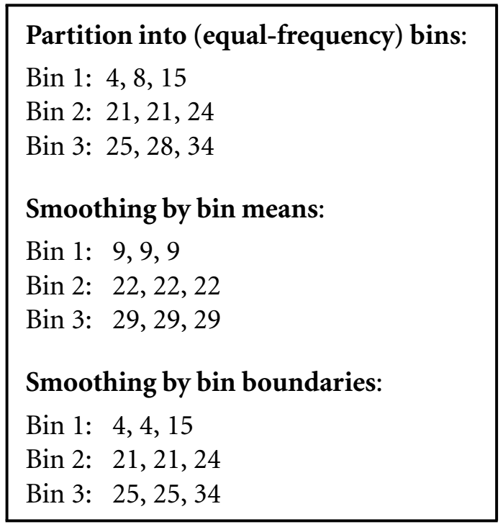
How to Handle Noisy Data?
Binning:
first sort data .
4, 8, 15, 21, 21, 24, 25, 28, 34
partition into (equal-frequency) bins.
then one can smooth by bin means
smooth by bin median
smooth by bin boundaries, etc.
bins may be equal width, where the interval range of values in each bin is constant.

Slide 11
How to Handle Noisy Data?
Regression
Data smoothing can also be done by regression, a technique that conforms data values to a function.
Linear regression involves finding the “best” line to fit two attributes (or variables) so that one attribute can be used to predict the other.
Multiple linear regression is an extension of linear regression, where more than two attributes are involved and the data are fit to a multidimensional surface.
Clustering
Outliers may be detected by clustering, for example, where similar values are organized into groups, or “clusters.” Intuitively, values that fall outside of the set of clusters may be considered outliers.
Detect and remove outliers

Slide 12
Data Cleaning as a Process
Data discrepancy detection
Use metadata (e.g., domain, range, dependency, distribution)
Check field overloading: squeeze new attribute definitions into unused (bit) portions of already defined attributes.
Check uniqueness rule: each value of the given attribute must be different from all other values for that attribute
Consecutive rule: there can be no missing values between the lowest and highest values for the attribute, and that all values must also be unique
Null rule: blanks, question marks, special characters, or other strings that may indicate the null condition, and how such values should be handled.

Slide 13
Data Cleaning as a Process
Data discrepancy detection
Use commercial tools
Data scrubbing: use simple domain knowledge (e.g., postal code, spell-check) to detect errors and make corrections
Data auditing: by analyzing data to discover rules and relationship to detect violators (e.g., correlation and clustering to find outliers)

Slide 14
Data Cleaning as a Process
Data migration and integration
Data migration tools: allow simple transformations to be specified such as to replace the string “gender” by “sex.”
ETL (Extraction/Transformation/Loading) tools: allow users to specify transformations through a graphical user interface (GUI).
Integration of the two processes
Iterative and interactive: Potter’s Wheel, for example, is a publicly available data cleaning tool that integrates discrepancy detection and transformation.

Slide 15
2. Data Integration
Data integration Introduction:
Combines data from multiple sources into a coherent store.
Careful integration can help reduce and avoid redundancies and inconsistencies in the resulting data set.
Integrate metadata from different sources
Semantic heterogeneity and structure of data pose great challenges in data integration.
Entity Identification Problem
Redundancy and Correlation Analysis
Tuple Duplication
Data Value Conflict Detection and Resolution

Slide 16
Data Integration: Entity identification problem
Identify real world entities from multiple data sources.
Schema integration: e.g., customer_id & cust_number
Metadata for each attribute include the name, meaning, data type, and range of values permitted for the attribute, and null rules for handling blank, zero, or null values.
Such metadata can be used to help avoid errors in schema integration.

Slide 17
Data Integration: Redundancy and Correlation Analysis
Redundancy is another important issue in data integration. An attribute (such as annual revenue, for instance) may be redundant if it can be derived from another attribute or set of attributes.
Inconsistencies in attribute or dimension naming can also cause redundancies in the resulting data set.
Some redundancies can be detected by correlation analysis. Given two attributes, such analysis can measure how strongly one attribute implies the other, based on the available data.
χ 2 (chi-square) test for Nominal Data
Correlation Coefficient for Numeric Data
Covariance of Numeric Data

Slide 18
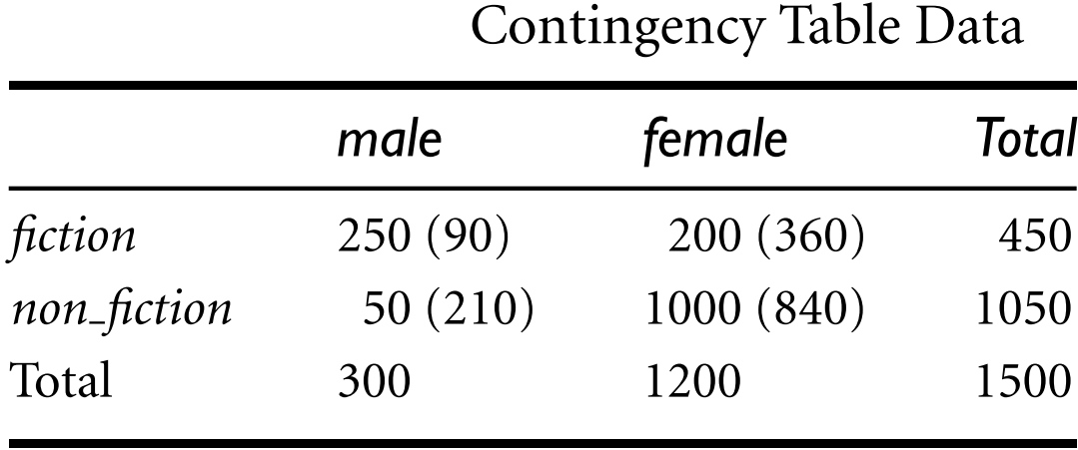
Data Integration: Redundancy and Correlation Analysis
χ 2 (chi-square) test for Nominal Data
Correlation relationship between two attributes, A and B, can be discovered by a χ 2 (chi-square) test.
Suppose A has c distinct values, namely a₁,a₂,…,a_{c}.
B has r distinct values, namely b₁, b₂,…,b_{r}.
The c values of A making up the columns and the r values of B making up the rows.
*Note: Are gender and
preferred reading correlated?

Slide 19
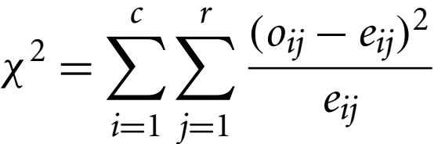
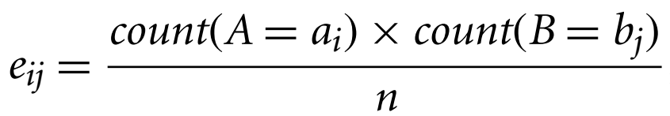
Data Integration: Redundancy and Correlation Analysis
χ 2 (chi-square) test for Nominal Data
The χ 2 value (also known as the Pearson χ 2 statistic) is computed as:
where o_{ij} is the observed frequency (i.e., actual count) of the joint event (A_{i}, B_{j}) and e_{ij} is the expected frequency of (A_{i}, B_{j}), which can be computed as:
where n is the number of data tuples.
count(A = a_{i}) is the number of tuples having value a_{i} for A.
count(B = b_{j}) is the number of tuples having value b_{j} for B.

Slide 20
Data Integration: Redundancy and Correlation Analysis
χ 2 (chi-square) test for Nominal Data
The χ 2 value (also known as the Pearson χ 2 statistic) is computed as:
*Note: Are gender and
preferred reading correlated?
In any row, the sum of the expected frequencies must equal the total observed frequency for that row, and the sum of the expected frequencies in any column must also equal the total observed frequency for that column.

Slide 21
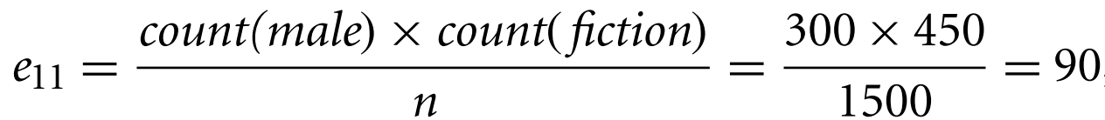
Data Integration: Redundancy and Correlation Analysis
χ 2 (chi-square) test for Nominal Data
The χ 2 value (also known as the Pearson χ 2 statistic) is computed as:
*Note: Are gender and
preferred reading correlated?

Slide 22
Data Integration: Redundancy and Correlation Analysis
χ 2 (chi-square) test for Nominal Data
The χ 2 value (also known as the Pearson χ 2 statistic) is computed as:
*Note: Are gender and
preferred reading correlated?
300 | 450 | 135000 | 1500 | 90
1200 | 450 | 540000 | 1500 | 360
300 | 1050 | 315000 | 1500 | 210
1200 | 1050 | 1260000 | 1500 | 840

Slide 23
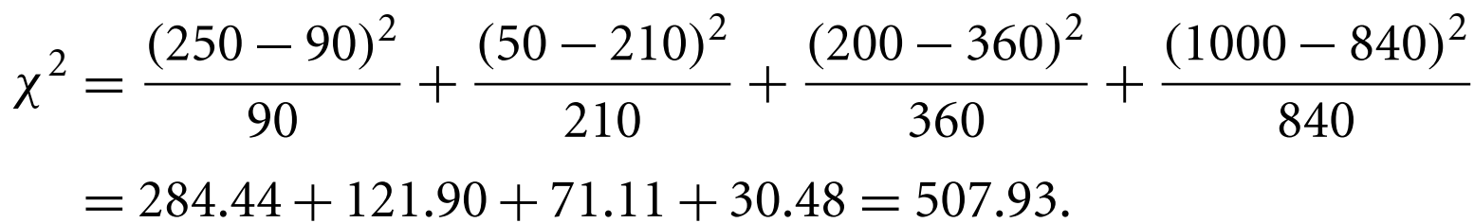
Data Integration: Redundancy and Correlation Analysis
χ 2 (chi-square) test for Nominal Data
The χ 2 value (also known as the Pearson χ 2 statistic) is computed as:
Degrees of freedom
*Note: Are gender and
preferred reading correlated?

Slide 24
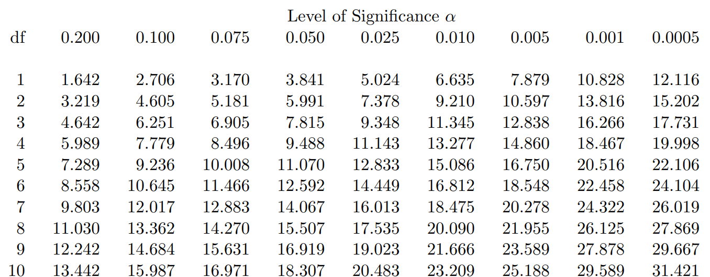
Table of the chi square distribution:Degrees of freedom
Note- Since our computed value is above this, we can reject the hypothesis that gender and preferred reading are independent and conclude that the two attributes are (strongly) correlated for the given group of people.

Slide 25
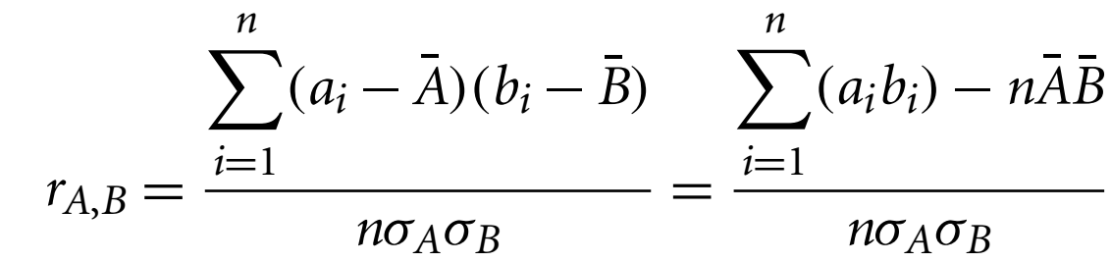

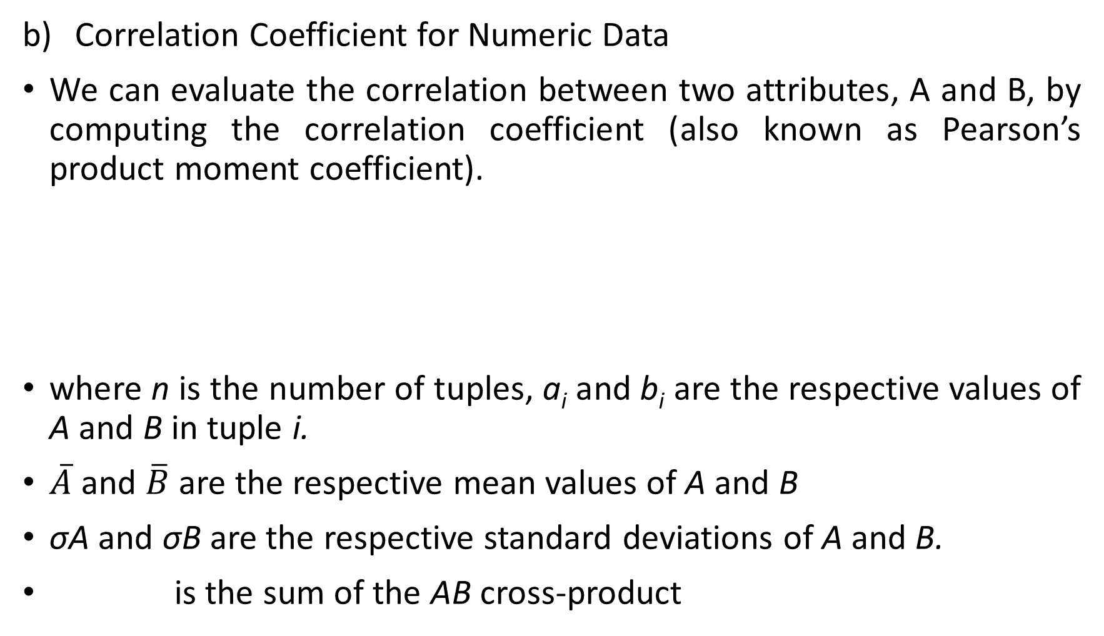
Data Integration: Redundancy and Correlation Analysis
Correlation Coefficient for Numeric Data
We can evaluate the correlation between two attributes, A and B, by computing the correlation coefficient (also known as Pearson’s product moment coefficient).
where n is the number of tuples, a_{i} and b_{i} are the respective values of A and B in tuple i.
$\overline{A}$ and $\overline{B}$ are the respective mean values of A and B
σA and σB are the respective standard deviations of A and B.
is the sum of the AB cross-product

Slide 26
Data Integration: Redundancy and Correlation Analysis
Correlation Coefficient for Numeric Data
We can evaluate the correlation between two attributes, A and B, by computing the correlation coefficient (also known as Pearson’s product moment coefficient).
If rA,B > 0, A and B are positively correlated (A’s values increase as B’s). The higher, the stronger correlation.
rA,B = 0: independent
rAB < 0: negatively correlated

Slide 27
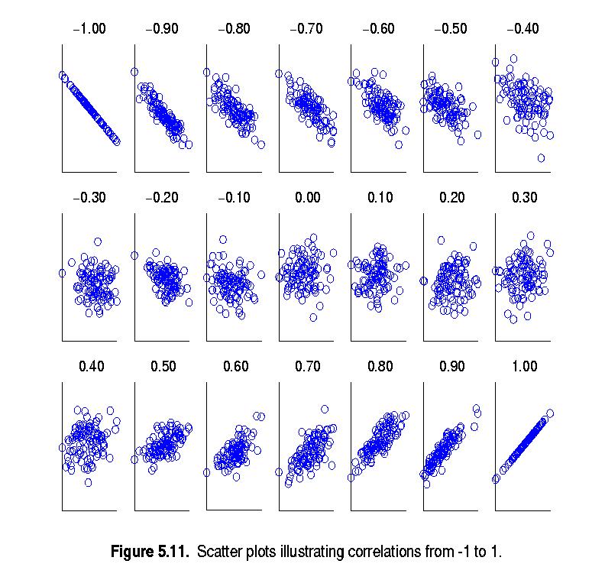
Visually Evaluating Correlation
Scatter plots showing the similarity from –1 to 1.

Slide 28
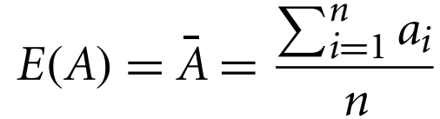
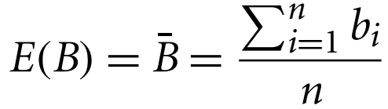
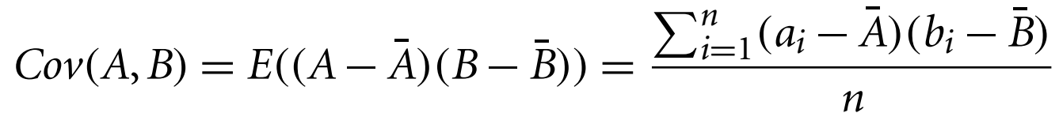
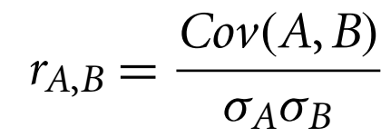

Data Integration: Redundancy and Correlation Analysis
Covariance of Numeric Data
Consider two numeric attributes A and B, and a set of n observations {(a₁,b₁),…,(a_{n},b_{n})}. The mean values of A and B, respectively, are also known as the expected values on A and B, that is.
The covariance between A and B is defined as:
If we compare function r_{A,B} (correlation coefficient) with covariance, we see that
Covariance also be shown as

Slide 29
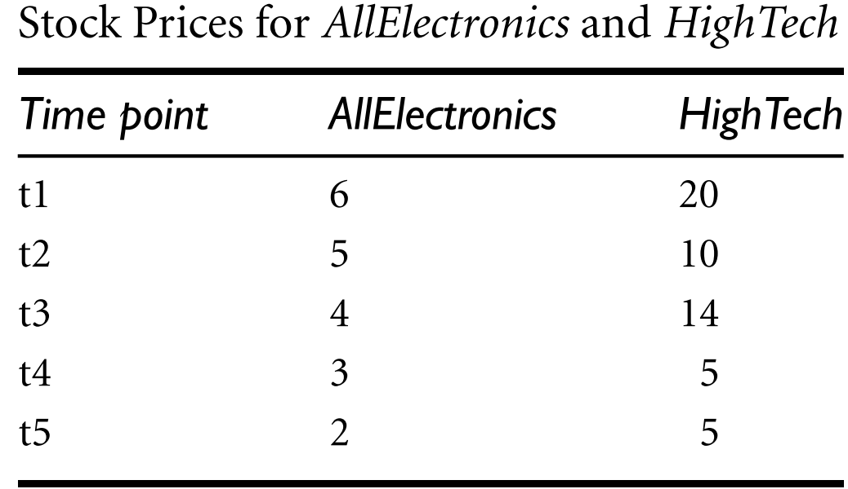
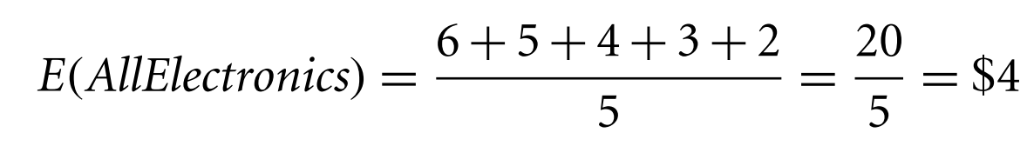
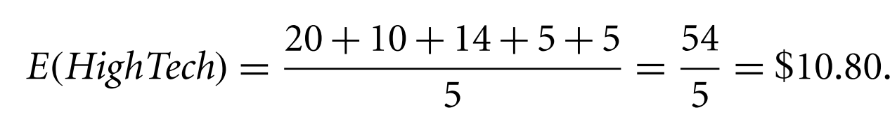
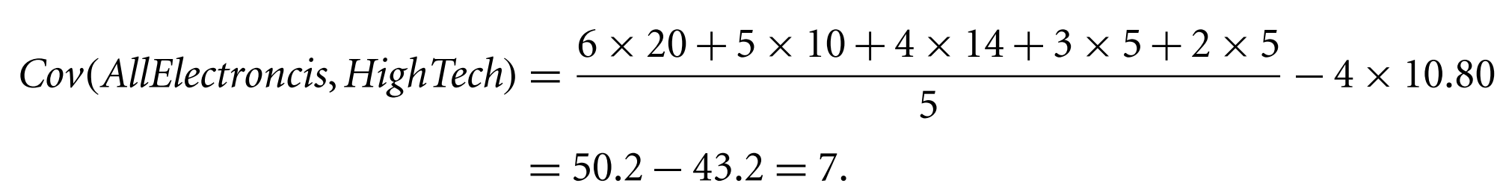
Data Integration: Redundancy and Correlation Analysis
Covariance of Numeric Data

Slide 30
Data Integration: Redundancy and Correlation Analysis
Covariance of Numeric Data
Therefore, given the positive covariance we can say that stock prices for both companies rise together.

Slide 31
Data Integration: Tuple Duplication
In addition to detecting redundancies between attributes, duplication should also be detected at the tuple level (e.g., where there are two or more identical tuples for a given unique data entry case).
For example, if a purchase order database contains attributes for the purchaser’s name and address instead of a key to this information in a purchaser database, discrepancies can occur, such as the same purchaser’s name appearing with different addresses within the purchase order database.

Slide 32
Data Integration: Data Value Conflict Detection and Resolution
In real-world entity, attribute values from different sources may differ. This may be due to differences in representation, scaling, or encoding.
For instance, a weight attribute may be stored in metric units in one system and British imperial units in another.
For a hotel chain, the price of rooms in different cities may involve not only different currencies but also different services (e.g., free breakfast) and taxes.
When exchanging information between schools, for example, each school may have its own curriculum and grading scheme. One university may adopt a quarter system, offer three courses on database systems, and assign grades from AC to F, whereas another may adopt a semester system, offer two courses on databases, and assign grades from 1 to 10.

Slide 33
3. Data Reduction
Data reduction techniques can be applied to obtain a reduced representation of the data set that is much smaller in volume, yet closely maintains the integrity of the original data.
Mining on the reduced data set should be more efficient yet produce the same (or almost the same) analytical results.
Data reduction strategies include
Dimensionality reduction
Numerosity reduction
Data compression.

Slide 34
3. Data Reduction
Dimensionality reduction is the process of reducing the number of random variables or attributes under consideration.
Dimensionality reduction methods include wavelet transforms and principal components analysis (PCA).
Attribute subset selection is a method of dimensionality reduction in which irrelevant, weakly relevant, or redundant attributes or dimensions are detected and removed.

Slide 35
3. Data Reduction
Numerosity reduction techniques replace the original data volume by alternative, smaller forms of data representation.
Numerosity reduction techniques are parametric or nonparametric.
For parametric methods, a model is used to estimate the data, so that typically only the data parameters need to be stored, instead of the actual data. (Outliers may also be stored.)
Regression and log-linear models are examples.
Nonparametric methods for storing reduced representations of the data include histograms, clustering, sampling, and data cube aggregation.

Slide 36
3. Data Reduction
Data Compression transformations are applied so as to obtain a reduced or “compressed” representation of the original data.
Lossless: If the original data can be reconstructed from the compressed data without any information loss.
Lossy: If we can reconstruct only an approximation of the original data.
There are several lossless algorithms for string compression; however, they typically allow only limited data manipulation.
Dimensionality reduction and numerosity reduction techniques can also be considered forms of data compression.

Slide 37
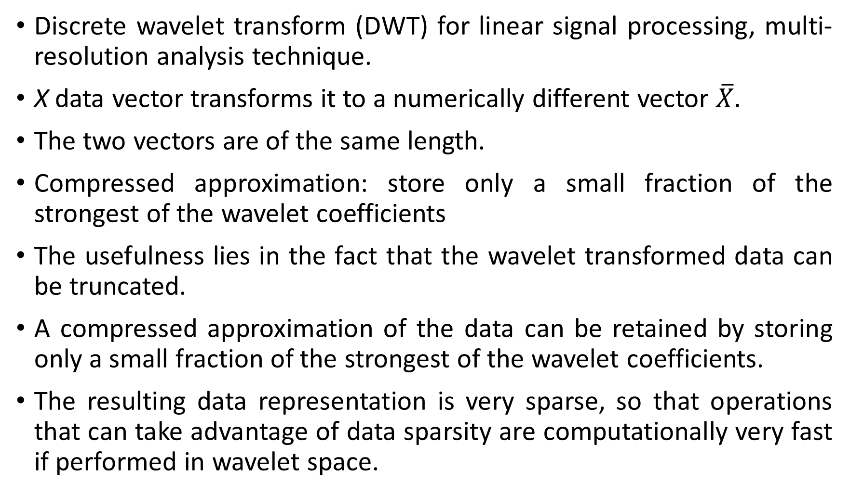
1) Dimensionality Reduction: Wavelet Transforms
Discrete wavelet transform (DWT) for linear signal processing, multi-resolution analysis technique.
X data vector transforms it to a numerically different vector $\overline{X}.$
The two vectors are of the same length.
Compressed approximation: store only a small fraction of the strongest of the wavelet coefficients
The usefulness lies in the fact that the wavelet transformed data can be truncated.
A compressed approximation of the data can be retained by storing only a small fraction of the strongest of the wavelet coefficients.
The resulting data representation is very sparse, so that operations that can take advantage of data sparsity are computationally very fast if performed in wavelet space.

Slide 38
1) Dimensionality Reduction: Wavelet Transforms
The technique also works to remove noise without smoothing out the main features of the data, making it effective for data cleaning as well.
Popular wavelet transforms include the Haar-2, Daubechies-4, and Daubechies-6.
The general procedure for applying a discrete wavelet transform uses a hierarchical pyramid algorithm that halves the data at each iteration, resulting in fast computational speed.

Slide 39
1) Dimensionality Reduction: Wavelet Transforms
Similar to discrete Fourier transform (DFT), but better lossy compression, localized in space
Method:
The length, L, of the input data vector must be an integer power of 2. This condition can be met by padding the data vector with zeros as necessary (L ≥ n).
Each transform has 2 functions: smoothing: such as a weighted average, difference: acts to bring out the detailed features of the data.
The two functions are applied to pairs of data points in X. This results in two data sets of length L/2.
Applies two functions recursively, until reaches the desired length.
Selected values are designated the wavelet coefficients of the transformed data.

Slide 40
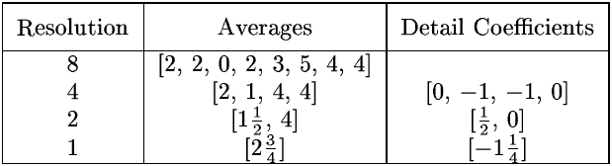

1) Dimensionality Reduction: Wavelet Transforms
Wavelets: A math tool for space-efficient hierarchical decomposition of functions
S = [2, 2, 0, 2, 3, 5, 4, 4] can be transformed to
$\overline{S}$ = [2³/₄, -1¹/₄, ¹/₂, 0, 0, -1, -1, 0]
Compression: many small detail coefficients can be replaced by 0’s, and only the significant coefficients are retained.

Slide 41
1) Dimensionality Reduction: Wavelet Transforms- Haar
Hierarchical decomposition structure (a.k.a. “error tree”)
Coefficient “Supports”
₊
2.75
₋
2.75
+
₊
-1.25
-1.25
₋
+
-
₊
0.5
₋
0.5
0
₊
+
-
+
-
0
₋
0
-1
-1
0
₊
+
0
₋
-
+
-
+
-
+
-
₊
₋
2 2 0 2 3 5 4 4
-1
₊
-1
₋
₊
Original frequency distribution
0
Notes:
41

Slide 42

1) Dimensionality Reduction: Wavelet Transforms
Example:
S = [56, 40, 8, 24, 48, 48, 40, 16] can be transformed to $\overline{S}$ = [35, -3, 16, 10, 8, -8 ,0, 12] or $\overline{S}$ = [35, 0, 16, 10, 8, 0 ,0, 12]

Slide 43
1) Dimensionality Reduction: Wavelet Transforms
Use hat-shape filters
Emphasize region where points cluster
Suppress weaker information in their boundaries
Effective removal of outliers
Insensitive to noise, insensitive to input order
Multi-resolution
Detect arbitrary shaped clusters at different scales
Efficient
Complexity O(N)
Only applicable to low dimensional data

Slide 44
1) Dimensionality Reduction: PCA
Principal components analysis (also called the Karhunen-Loeve, or K-L method) searches for k n-dimensional orthogonal vectors that can best be used to represent the data, where k ≤ n.
Find a projection that captures the largest amount of variation in data
The original data are projected onto a much smaller space, resulting in dimensionality reduction. We find the eigenvectors of the covariance matrix, and these eigenvectors define the new space
x₂
e
x₁

Slide 45
1) Dimensionality Reduction: PCA
The original data are thus projected onto a much smaller space, resulting in dimensionality reduction.
Normalize input data: Each attribute falls within the same range.
Compute k orthonormal (unit) vectors, i.e., principal components.
Each input data (vector) is a linear combination of the k principal component vectors.
The principal components are sorted in order of decreasing “significance” or strength.
Since the components are sorted, the size of the data can be reduced by eliminating the weak components, i.e., those with low variance (i.e., using the strongest principal components, it is possible to reconstruct a good approximation of the original data)
Works for numeric data only

Slide 46
1) Dimensionality Reduction: PCA
Steps for PCA:
Step 1: Standardization (or Data normalization):
PCA normalized the input data, so that each attribute falls within the same range.
Normalization helps ensure that attributes with large domains will not dominate attributes with smaller domains.
Calculate mean.

Slide 47
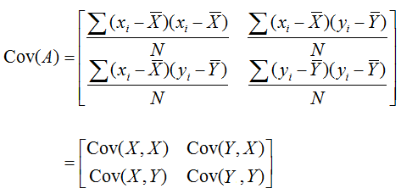
1) Dimensionality Reduction: PCA
Steps for PCA:
Step 2: Covariance matrix (Find Covariance Matrix to identify correlation):
This step calculates the covariance matrix of the standardized data.
Covariance matrix shows how each variable is related to every other variable in the dataset.
If the value of the Covariance Matrix is positive, then it indicates that the variables are correlated. (If X increases, Y also increases and vice versa)
If the value of the Covariance Matrix is negative, then it indicates that the variables are inversely correlated. (If X increases, Y also decreases and vice versa).
If the value of the Covariance Matrix is zero, then the variables are no correlated.

Slide 48
1) Dimensionality Reduction: PCA
Step 3: Calculate eigen value of the Covariance matrix:
Characteristic equation is used to find eigen values.
det(A- λI) = 0
where I is the identity matrix and det(B) is the determinant of the matrix B.
From the determinant of the matrix, we can find Quadratic equation and can find the λ.
The solutions λ of the characteristic equation are the eigenvalues.
An eigenvalue is a number representing the amount of variance present in the data for a given direction.
N by N matrix has N eigen values.

Slide 49
1) Dimensionality Reduction: PCA
Step 4: Find eigen vectors of the Covariance matrix:
[A- λI]X = 0 or AX= λX
The eigenvectors represent the directions in which the data varies the most, while the eigenvalues represent the amount of variation along each eigenvector.
Each eigenvector has its corresponding eigenvalue.

Slide 50
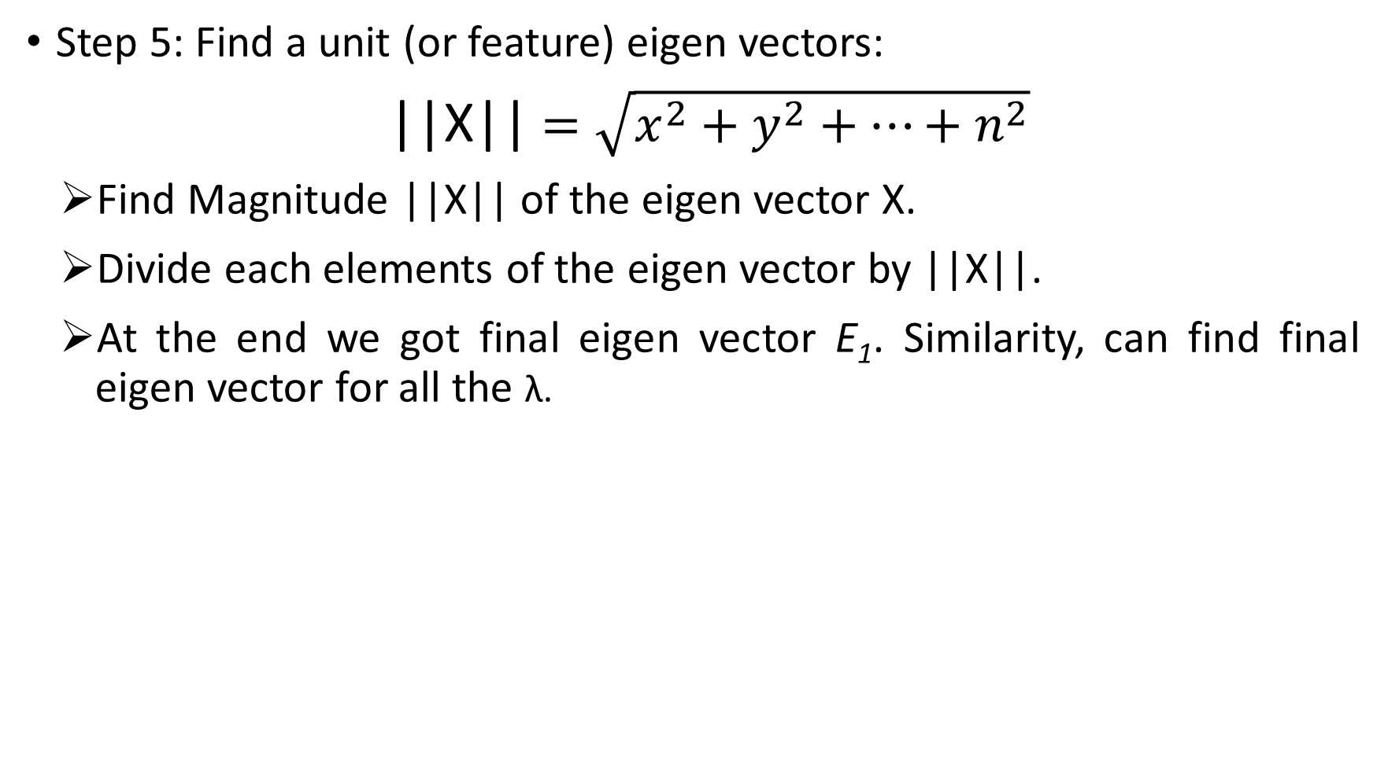
1) Dimensionality Reduction: PCA
Step 5: Find a unit (or feature) eigen vectors:
||X|| $=\sqrt{x^{2}+y^{2}+…+n^{2}}$
Find Magnitude ||X|| of the eigen vector X.
Divide each elements of the eigen vector by ||X||.
At the end we got final eigen vector E₁. Similarity, can find final eigen vector for all the λ.

Slide 51
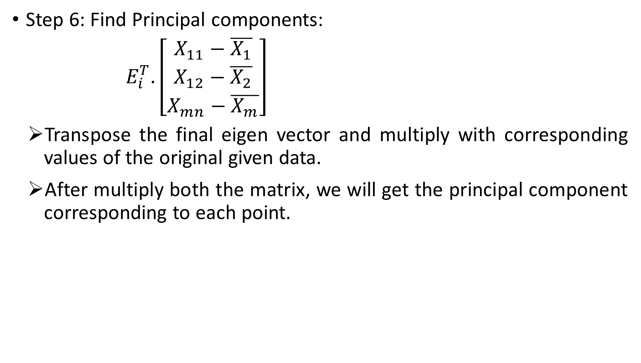
1) Dimensionality Reduction: PCA
Step 6: Find Principal components:
$E_{i}^{T}.\left[\begin{aligned}\begin{aligned}X_{11}−\overline{X_{1}} \\ X_{12}−\overline{X_{2}}\end{aligned} \\ X_{mn}−\overline{X_{m}}\end{aligned}\right]$
Transpose the final eigen vector and multiply with corresponding values of the original given data.
After multiply both the matrix, we will get the principal component corresponding to each point.

Slide 52
1) Dimensionality Reduction: PCA
Step 7: Transform the data (Visualization):
The final step is to transform the original data into the lower-dimensional space defined by the principal components.
The transformation does not modify the original data itself but instead provides a new perspective to better represent the data.

Slide 53


1) Dimensionality Reduction: PCA
Example1:
Step 1: Standardization (or Data normalization):
Calculate mean
$$\overline{X_{1}}=8,$$
$$\overline{X_{2}}=8.5$$
Step 2: Find Covariance matrix:
Feature | X₁ | X₂
E1 | 4 | 11
E2 | 8 | 4
E3 | 13 | 5
E4 | 7 | 14
$$\left[\begin{aligned}\begin{aligned}14 −11\end{aligned} \\ −11 23\end{aligned}\right]$$

Slide 54


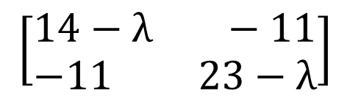
1) Dimensionality Reduction: PCA
Example1 continue…
Step 3 Calculate eigen value of the Covariance matrix :
det(A- λI) = 0
$$\left(14−λ\right)\left(23−λ\right)−(−11×−11)$$
$$λ^{2}−37λ+201$$
$$λ_{1}=30.3849$$
$$λ_{2}=6.6151$$
$λ_{1}$and $λ_{2}$ are our eigen values.
$$\left[\begin{aligned}\begin{aligned}14 −11\end{aligned} \\ −11 23\end{aligned}\right]$$
$$\left[\begin{aligned}\begin{aligned}14−λ −11\end{aligned} \\ −11 23−λ\end{aligned}\right]$$

Slide 55
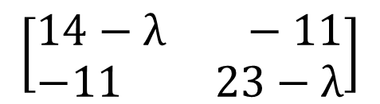
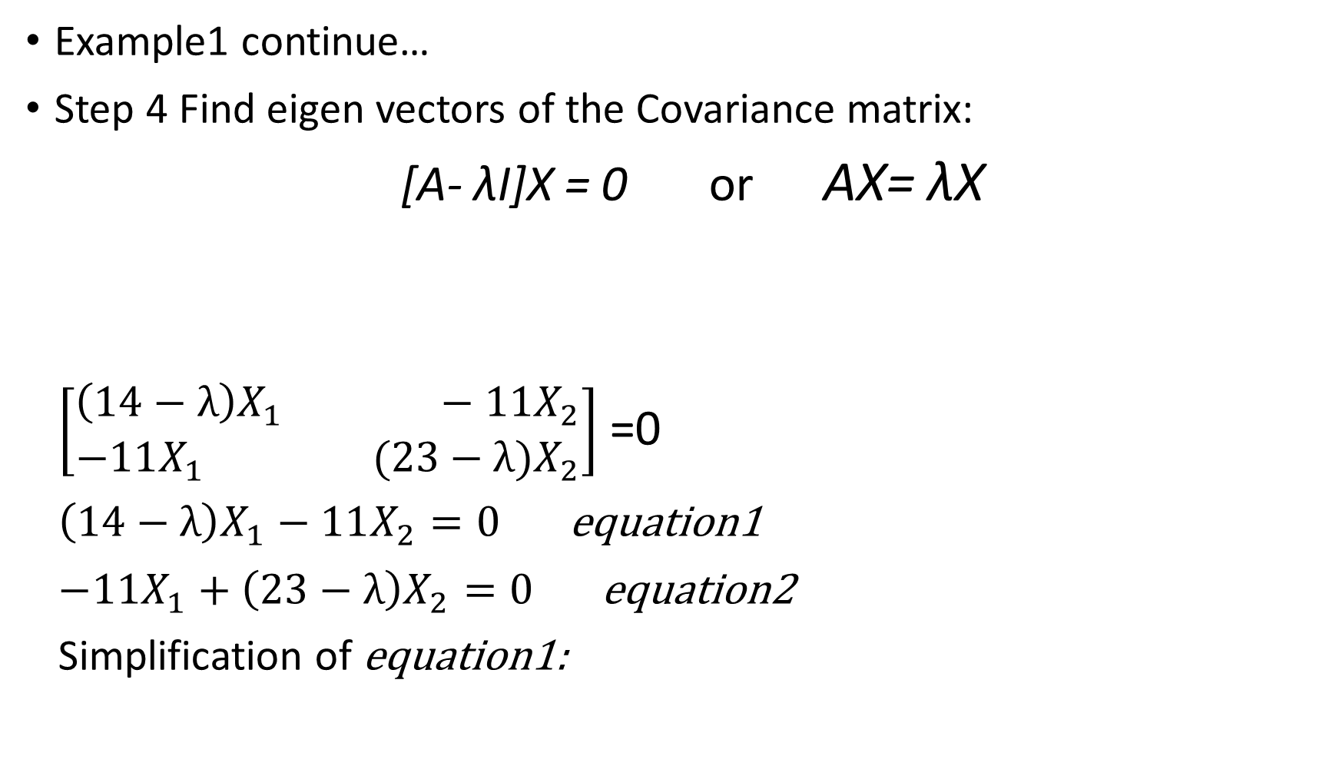
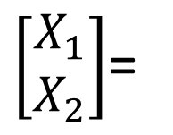

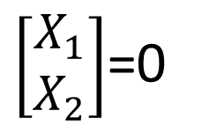
1) Dimensionality Reduction: PCA
Example1 continue…
Step 4 Find eigen vectors of the Covariance matrix:
[A- λI]X = 0 or AX= λX
$\left[\begin{aligned}\begin{aligned}\left(14−λ\right)X_{1} −11X_{2}\end{aligned} \\ −11X_{1} (23−λ)X_{2}\end{aligned}\right]$ =0
$\left(14−λ\right)X_{1}−11X_{2}=0$ equation1
$−11X_{1}+\left(23−λ\right)X_{2}=0$ equation2
Simplification of equation1:
$$\left[\begin{aligned}\begin{aligned}14−λ −11\end{aligned} \\ −11 23−λ\end{aligned}\right]$$
$\left[\begin{aligned}X_{1} \\ X_{2}\end{aligned}\right]$=0
$\left[\begin{aligned}X_{1} \\ X_{2}\end{aligned}\right]$=
$$\left[\begin{aligned}\begin{aligned}11\end{aligned} \\ 14−λ\end{aligned}\right]$$

Slide 56
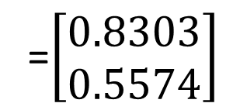



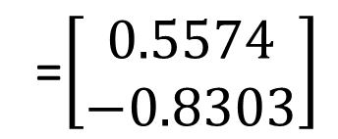

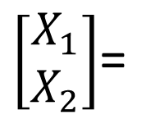
1) Dimensionality Reduction: PCA
$\left[\begin{aligned}X_{1} \\ X_{2}\end{aligned}\right]$=
$$\left[\begin{aligned}\begin{aligned}11\end{aligned} \\ 14−λ\end{aligned}\right]$$
Example1 continue…
Step 5: Find a unit (or feature) eigen vectors:
||X|| $=\sqrt{x^{2}+y^{2}+…+n^{2}}$
= $\sqrt{{11}^{2}+{(14−λ_{1})}^{2}}$
=19.7348
$$E_{1}=\left[\begin{aligned}{11}/{19.7348} \\ {(14−λ_{1})}/{19.7348}\end{aligned}\right]$$
=$\left[\begin{aligned}0.5574 \\ −0.8303\end{aligned}\right]$
$$E_{2}=\left[\begin{aligned}{11}/{19.7348} \\ {(14−λ_{1})}/{19.7348}\end{aligned}\right]$$
=$\left[\begin{aligned}0.8303 \\ 0.5574\end{aligned}\right]$

Slide 57




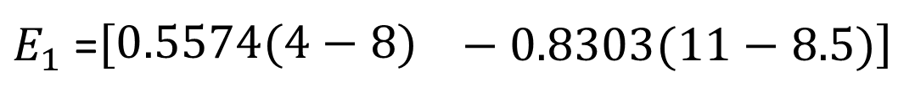
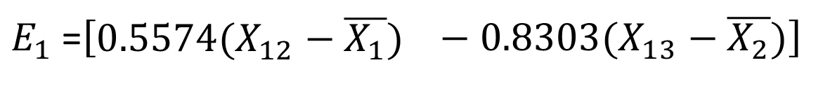
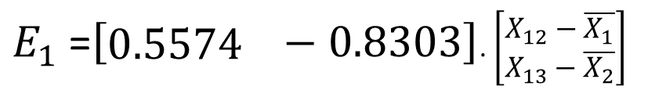

1) Dimensionality Reduction: PCA
Example1 continue…
Step 6: Find Principal components:
$E_{1}^{T}.\left[\begin{aligned}\begin{aligned}X_{12}−\overline{X_{1}} \\ X_{13}−\overline{X_{2}}\end{aligned}\end{aligned}\right]$
Feature | X₁ | X₂
E1 | 4 | 11
E2 | 8 | 4
E3 | 13 | 5
E4 | 7 | 14
$$−5.1240$$
$$5.6930$$
$$3.7363−4.3053$$
$E_{1}$=$\left[\begin{aligned}0.5574\end{aligned} −0.8303\right]$. $\left[\begin{aligned}\begin{aligned}X_{12}−\overline{X_{1}} \\ X_{13}−\overline{X_{2}}\end{aligned}\end{aligned}\right]$
$$\overline{X_{1}}=8,$$
$$\overline{X_{2}}=8.5$$
$E_{1}$=$\left[\begin{aligned}0.5574(X_{12}−\overline{X_{1}})\end{aligned} −0.8303(X_{13}−\overline{X_{2}})\right]$
$E_{1}$=$\left[\begin{aligned}0.5574(4−8)\end{aligned} −0.8303(11−8.5)\right]$
$$−4.3053$$
$E_{1}$=$\left[\begin{aligned}0.5574 \\ −0.8303\end{aligned}\right]$

Slide 58
1) Dimensionality Reduction: Attribute Subset Selection
Data sets for analysis may contain hundreds of attributes, many of which may be irrelevant to the mining task or redundant.
Redundant attributes.
Duplicate much or all of the information contained in one or more other attributes
E.g., purchase price of a product and the amount of sales tax paid
Irrelevant attributes
Contain no information that is useful for the data mining task at hand
E.g., students' ID is often irrelevant to the task of predicting students' GPA
Added volume of irrelevant or redundant attributes can slow down the mining process. It discovered patterns of poor quality.

Slide 59
1) Dimensionality Reduction: Attribute Subset Selection
Attribute subset selection also called feature subset selection.
Attribute subset selection reduces the data set size by removing irrelevant or redundant attributes (or dimensions).
The goal of attribute subset selection is to find a minimum set of attributes such that the resulting probability distribution of the data classes is as close as possible to the original distribution obtained using all attributes.
It reduces the number of attributes appearing in the discovered patterns, helping to make the patterns easier to understand.

Slide 60
1) Dimensionality Reduction: Attribute Subset Selection
For n attributes, there are 2^{n} possible subsets.
An exhaustive search for the optimal subset of attributes can be prohibitively expensive, especially as n and the number of data classes increase.
So, heuristic methods that explore a reduced search space are commonly used for attribute subset selection.
Heuristic methods are typically greedy in that, while searching through attribute space, they always make what looks to be the best choice at the time.
Their strategy is to make a locally optimal choice in the hope that this will lead to a globally optimal solution.
Such greedy methods are effective in practice and may come close to estimating an optimal solution.

Slide 61
1) Dimensionality Reduction: Attribute Subset Selection
The “best” (and “worst”) attributes are typically determined using tests of statistical significance, which assume that the attributes are independent of one another.
Many other attribute evaluation measures can be used such as the information gain measure used in building decision trees for classification.

Slide 62

1) Dimensionality Reduction: Attribute Subset Selection
Figure: Greedy (heuristic) methods for attribute subset selection.

Slide 63
1) Dimensionality Reduction: Attribute Subset Selection
1. Stepwise forward selection: The procedure starts with an empty set of attributes as the reduced set. The best of the original attributes is determined and added to the reduced set.
2. Stepwise backward elimination: The procedure starts with the full set of attributes. At each step, it removes the worst attribute remaining in the set.
3. Combination of forward selection and backward elimination: The procedure selects the best attribute and removes the worst from among the remaining attributes.

Slide 64
1) Dimensionality Reduction: Attribute Subset Selection
4. Decision tree induction: Decision tree algorithms (e.g., ID3, C4.5, and CART) were originally intended for classification.
Decision tree induction constructs a flowchart like structure where each internal (non-leaf) node denotes a test on an attribute.
Each branch corresponds to an outcome of the test, and each external (leaf) node denotes a class prediction.
At each node, the algorithm chooses the best attribute to partition the data into individual classes.
The stopping criteria for the methods may vary.
The procedure may employ a threshold on the measure used to determine when to stop the attribute selection process.

Slide 65

2) Numerosity reduction: Regression and log-linear models
In (simple) linear regression, the data are modeled to fit a straight line.
Linear regression finds the linear relationship between the dependent variable and independent variable using a best-fit straight line.
It aims to find the best-fitting line for predicting future values.
The slope indicates the rate of change of the dependent variable w.r.t the difference in the independent quantities.
The intercept indicates the value of the dependent variable when the independent variable is zero.

Slide 66

2) Numerosity reduction: Regression and log-linear models
$y=wx+b$
x is an Independent numeric attribute.
y is a dependent numeric attribute.
w is the gradient or slope of the line.
b is the intercept or height at which line crosses the y axis.
The coefficients, w and b (called regression coefficients).

Slide 67

2) Numerosity reduction: Regression and log-linear models
$y=wx+b$
$w=\frac{Cov(x,y)}{Var(x)}$
$b=\overline{y}−w.\overline{x}$
$w=\frac{\sum{(x−\overline{x})(y−\overline{y})}}{\sum{{(x−\overline{x})}^{2}}}$

Slide 68

2) Numerosity reduction: Regression and log-linear models
$$y=wx+b$$
$w=\frac{Cov(x,y)}{Var(x)}$
$b=\overline{y}−w . \overline{x}$
$$w=\frac{\sum{(x−\overline{x})(y−\overline{y})}}{\sum{{(x−\overline{x})}^{2}}}$$
$$w=\frac{60}{40}=1.5$$
$b=16−1.5 ×12=−2$
x | y | mean x | mean y | deviation x | deviation y | product deviation | sum of deviation | square deviation x
8 | 10 | 12 | 16 | -4 | -6 | 24 | 60 | 16
10 | 13 | 12 | 16 | -2 | -3 | 6 | 60 | 4
12 | 16 | 12 | 16 | 0 | 0 | 0 | 60 | 0
14 | 19 | 12 | 16 | 2 | 3 | 6 | 60 | 4
16 | 22 | 12 | 16 | 4 | 6 | 24 | 60 | 16
60 | 80 |  |  |  |  | 60 |  | 40

Slide 69

2) Numerosity reduction: Regression and log-linear models
$$y=wx+b$$
$w=\frac{Cov(x,y)}{Var(x)}$
$b=\overline{y}−w . \overline{x}$
$$w=\frac{\sum{(x−\overline{x})(y−\overline{y})}}{\sum{{(x−\overline{x})}^{2}}}$$
$$w=\frac{60}{40}=1.5$$
$b=16−1.5 ×12=−2$
If the value of x is 18, find the value of y?.
x | y | mean x | mean y | deviation x | deviation y | product deviation | sum of deviation | square deviation x
8 | 10 | 12 | 16 | -4 | -6 | 24 | 60 | 16
10 | 13 | 12 | 16 | -2 | -3 | 6 | 60 | 4
12 | 16 | 12 | 16 | 0 | 0 | 0 | 60 | 0
14 | 19 | 12 | 16 | 2 | 3 | 6 | 60 | 4
16 | 22 | 12 | 16 | 4 | 6 | 24 | 60 | 16
60 | 80 |  |  |  |  | 60 |  | 40

Slide 70

2) Numerosity reduction: Regression and log-linear models
$$y=wx+b$$
$w=\frac{Cov(x,y)}{Var(x)}$
$b=\overline{y}−w . \overline{x}$
$$w=\frac{\sum{(x−\overline{x})(y−\overline{y})}}{\sum{{(x−\overline{x})}^{2}}}$$
$$w=\frac{60}{40}=1.5$$
$b=16−1.5 ×12=−2$
If the value of independent attribute is 20, then find the value of dependent attribute
x | y | mean x | mean y | deviation x | deviation y | product deviation | sum of deviation | square deviation x
8 | 10 | 12 | 16 | -4 | -6 | 24 | 60 | 16
10 | 13 | 12 | 16 | -2 | -3 | 6 | 60 | 4
12 | 16 | 12 | 16 | 0 | 0 | 0 | 60 | 0
14 | 19 | 12 | 16 | 2 | 3 | 6 | 60 | 4
16 | 22 | 12 | 16 | 4 | 6 | 24 | 60 | 16
60 | 80 |  |  |  |  | 60 |  | 40

Slide 71
2) Numerosity reduction: Regression and log-linear models
Log-linear models approximate discrete multidimensional probability distributions.
Given a set of tuples in n dimensions (e.g., described by n attributes), we can consider each tuple as a point in an n-dimensional space.
Log-linear models can be used to estimate the probability of each point in a multidimensional space for a set of discretized attributes, based on a smaller subset of dimensional combinations.
This allows a higher-dimensional data space to be constructed from lower-dimensional spaces.
Log-linear models used Backward Elimination Procedure to remove higher-dimensional data space (or to reduce dimensionality).

Slide 72
2) Numerosity reduction: Histograms
Histograms use binning to approximate data distributions and are a popular form of data reduction.
The histogram for an attribute A, partitions the data distribution of A into disjoint subsets, referred to as buckets or bins.
If each bucket represents only a single attribute–value/frequency pair, the buckets are called singleton buckets.
Often, buckets instead represent continuous ranges for the given attribute.

Slide 73

2) Numerosity reduction: Histograms
Example: A list of prices for commonly sold items are given.
The numbers have been sorted: 1, 1, 5, 5, 5, 5, 5, 8, 8, 10, 10, 10, 10, 12, 14, 14, 14, 15, 15, 15, 15, 15, 15, 18, 18, 18, 18, 18, 18, 18, 18, 20, 20, 20, 20, 20, 20, 20, 21, 21, 21, 21, 25, 25, 25, 25, 25, 28, 28, 30, 30, 30.
Figure shows a histogram for the data using singleton buckets.

Slide 74

2) Numerosity reduction: Histograms
Example: A list of prices for commonly sold items are given.
The numbers have been sorted: 1, 1, 5, 5, 5, 5, 5, 8, 8, 10, 10, 10, 10, 12, 14, 14, 14, 15, 15, 15, 15, 15, 15, 18, 18, 18, 18, 18, 18, 18, 18, 20, 20, 20, 20, 20, 20, 20, 21, 21, 21, 21, 25, 25, 25, 25, 25, 28, 28, 30, 30, 30.
To further reduce the data, it is common to have each bucket denote a continuous value range for the given attribute.
In Figure, each bucket represents a different 10 range for price.

Slide 75
2) Numerosity reduction: Histograms
How are the buckets determined and the attribute values partitioned.
There are several partitioning rules, including the following:
Equal-width: In an equal-width histogram, the width of each bucket range is uniform (e.g., the width of 10 for the buckets in Figure).
Equal-frequency (or equal-depth): In an equal-frequency histogram, the buckets are created so that, roughly, the frequency of each bucket is constant (i.e., each bucket contains roughly the same number of contiguous data samples).
How are the buckets determined and the attribute values partitioned.

Slide 76
2) Numerosity reduction: Histograms
Histograms are highly effective at approximating both sparse and dense data, as well as highly skewed and uniform data.
The histograms described before for single attributes can be extended for multiple attributes.
Multidimensional histograms can capture dependencies between attributes.
These histograms have been found effective in approximating data with up to five attributes.
More studies are needed regarding the effectiveness of multidimensional histograms for high dimensionalities.
Singleton buckets are useful for storing high-frequency outliers.

Slide 77

2) Numerosity reduction: Clustering
Clustering techniques partition the objects into groups, or clusters, so that objects within a cluster are similar to one another and dissimilar to objects in other clusters.
Similarity is commonly defined in terms of how close the objects are in space, based on a distance function.
The quality of a cluster may be represented by its diameter, the maximum distance between any two objects in the cluster.

Slide 78
2) Numerosity reduction: Clustering
Figure shows a 2-D plot of customer data with respect to customer locations in a city. Three data clusters are visible.
Type of clustering models:
Centroid models:-K-Means, K-Medoid.
Hierarchical clustering:-Agglomerative Hierarchical Clustering, BIRCH (Balanced Iterative Reducing and Clustering using Hierarchies).
Distribution (probability-based) models: Expectation-maximization, Gaussian distribution.
Density models:-DBSCAN (Density-Based Spatial Clustering of Applications with Noise),OPTICS (Ordering Points to Identify the Clustering Structure)

Slide 79
2) Numerosity reduction: Clustering
In data reduction, the cluster representations of the data are used to replace the actual data.
The effectiveness of this technique depends on the data’s nature.
It is much more effective for data that can be organized into distinct clusters than for smeared data.

Slide 80

2) Numerosity reduction: Sampling
Sampling can be used as a data reduction technique because it allows a large data set to be represented by a much smaller random data sample (or subset).
Suppose that a large data set, D, contains N tuples.
Simple random sample without replacement (SRSWOR) of size s: This is created by drawing s of the N tuples from D, where the probability of drawing any tuple in D is 1/N, that is, all tuples are equally likely to be sampled.
Simple random sample with replacement (SRSWR) of size s: This is similar to SRSWOR, except that each time a tuple is drawn from D, it is recorded and then replaced. That is, after a tuple is drawn, it is placed back in D so that it may be drawn again.

Slide 81

2) Numerosity reduction: Sampling
Cluster sample: If the tuples in D are grouped into M mutually disjoint clusters, then an SRS of s clusters can be obtained.
For example, tuples in a database are usually retrieved a page at a time, so that each page can be considered a cluster.
A reduced data representation can be obtained by applying, say, SRSWOR to the pages, resulting in a cluster sample of the tuples.
Other clustering criteria conveying rich semantics can also be explored.

Slide 82

2) Numerosity reduction: Sampling
Stratified sample: D is divided into mutually disjoint parts called strata.
A stratified sample of D is generated by obtaining an SRS at each stratum.
Partition the data set, and draw samples from each partition (proportionally, i.e., approximately the same percentage of the data).

Slide 83


2) Numerosity reduction: Data Cube Aggregation
For example, you have data consist of the sales per quarter, for the years 2008 to 2010.
However, you are interested in the annual sales (total per year), rather than the total per quarter.
Thus, the data can be aggregated so that the resulting data summarize the total sales per year instead of per quarter.
The resulting data is smaller in volume, without loss of information necessary for the analysis task.

Slide 84
4. Data Transformation
In the preprocessing step, the data are transformed or consolidated so that the resulting mining process may be more efficient, and the patterns found may be easier to understand.
In data transformation, the data are transformed or consolidated into forms appropriate for mining.
Strategies or methods for data transformation
1. Smoothing: which works to remove noise from the data. Techniques include binning, regression, and clustering.
2. Attribute construction (or feature construction): where new attributes are constructed and added from the given set of attributes to help the mining process.

Slide 85
4. Data Transformation
3. Aggregation: where summary or aggregation operations are applied to the data. For example, the daily sales data may be aggregated so as to compute monthly and annual total amounts. This step is typically used in constructing a data cube for data analysis at multiple abstraction levels.
4. Normalization: where the attribute data are scaled so as to fall within a smaller range, such as −1.0 to 1.0, or 0.0 to 1.0.
5. Discretization: where the raw values of a numeric attribute (e.g., age) are replaced by interval labels (e.g., 0–10, 11–20, etc.) or conceptual labels (e.g., youth, adult, senior). The labels, in turn, can be recursively organized into higher-level concepts, resulting in a concept hierarchy for the numeric attribute.

Slide 86
4. Data Transformation
6. Concept hierarchy generation for nominal data: where attributes such as street can be generalized to higher-level concepts, like city or country. Many hierarchies for nominal attributes are implicit within the database schema and can be automatically defined at the schema definition level.
There is much overlap between the major data preprocessing tasks. The first three of these strategies were discussed earlier.
Smoothing is a form of data cleaning.
Attribute construction and aggregation were discussed on data reduction.
So, here we concentrate on the remaining three strategies.

Slide 87
4. Data Transformation: Data Transformation by Normalization
The measurement unit used can affect the data analysis.
For example, changing measurement units from meters to inches for height, or from kilograms to pounds for weight, may lead to very different results.
To avoid the issues of measurement units, the data must be normalized or standardized.
This involves transforming the data to fall within a smaller or common range such as [−1,1] or [0.0, 1.0].
Normalizing the data attempts to give all attributes an equal weight.
There are many methods for data normalization.
We study min-max normalization, z-score normalization, and normalization by decimal scaling.
Let A be a numeric attribute with n observed values, v₁, v₂, …, v_{n}.

Slide 88



4. Data Transformation: Data Transformation by Normalization
Min-max normalization performs a linear transformation on the original data.
Suppose that min_{A} and max_{A} are the minimum and maximum values of an attribute, A.
Min-max normalization maps a value, v_{i}, of A to in the range [new_min_{A}, new_max_{A}].
For a attribute income are $12,000 and $98,000, respectively. We would like to map income to the range [0.0, 1.0].
A given value of $73,600 for income is transformed to

Slide 89



4. Data Transformation: Data Transformation by Normalization
z-score normalization (or zero-mean normalization), the values for an attribute A, are normalized based on the mean (i.e., average) and standard deviation.
A value v_{i}, of A is normalized to
where and σA are the mean and standard deviation, respectively, of attribute A .
This method of normalization is useful when the actual minimum and maximum of attribute A are unknown, or when there are outliers that dominate the min-max normalization.

Slide 90



4. Data Transformation: Data Transformation by Normalization
Suppose that the mean and standard deviation of the values for the attribute income are $54,000 and $16,000, respectively.
With z-score normalization, a value of $73,600 for income is transformed to
A variation of this z-score normalization replaces the standard deviation by the mean absolute deviation of A. The mean absolute deviation of A, denoted s_{A}

Slide 91

4. Data Transformation: Data Transformation by Normalization
The mean absolute deviation s_{A}, is more robust to outliers than the standard deviation, σA.
When computing the mean absolute deviation, the deviations from the mean (i.e., $\left|x_{i}−\overline{x}\right|$) are not squared; therefore, the effect of outliers is somewhat reduced.

Slide 92



4. Data Transformation: Data Transformation by Normalization
Normalization by decimal scaling normalizes by moving the decimal point of values of attribute A.
The number of decimal points moved depends on the maximum absolute value of A.
The value v_{i} of A is normalized to
where j is the smallest integer such that
Suppose the values of A range from −986 to 917. The maximum absolute value of A is 986. To normalize by decimal scaling, we therefore divide each value by 1000 (i.e., j = 3) so that −986 normalizes to −0.986 and 917 normalizes to 0.917.

Slide 93
4. Data Transformation: Data Transformation by Normalization
Note that normalization can change the original data quite a bit, especially when using z-score normalization or decimal scaling.
It is also necessary to save the normalization parameters (e.g., the mean and standard deviation if using z-score normalization) so that future data can be normalized in a uniform manner.

Slide 94

4. Data Transformation: Data Transformation by Discretization
Discretization: Divide the range of a continuous attribute into intervals.
Interval labels can then be used to replace actual data values.
Reduce data size by discretization.
Supervised vs. unsupervised.
Split (top-down) vs. merge (bottom-up).
Discretization can be performed recursively on an attribute.
Prepare for further analysis, e.g., classification.

Slide 95
4. Data Transformation: Data Transformation by Discretization
Discretization by Binning (Unsupervised, Top-down)
Discretization by Histogram Analysis (Unsupervised, Top-down)
Discretization by Cluster (Unsupervised, Top-down)
Discretization by Decision Tree (Supervised, Top-down)
Discretization by Correlation Analyses (Supervised, Bottom-up)

Slide 96
4. Data Transformation: Data Transformation by Discretization
Discretization by Binning
Binning is a top-down splitting technique based on a specified number of bins.
Previously discussed binning methods for data smoothing. Those methods are also used as discretization methods for data reduction and concept hierarchy generation.
For example, attribute values can be discretized by applying equal-width or equal-frequency binning, and then replacing each bin value by the bin mean or median, as in smoothing by bin means or smoothing by bin medians, respectively.
These techniques can be applied recursively to the resulting partitions to generate concept hierarchies.
Binning does not use class information and is therefore an unsupervised discretization technique.

Slide 97
4. Data Transformation: Data Transformation by Discretization
Discretization by Histogram Analysis
Like binning, histogram analysis is an unsupervised discretization technique.
A histogram partitions the values of an attribute, A, into disjoint ranges called buckets or bins.
Equal-width histogram, the values are partitioned into equal-size partitions or ranges.
Equal-frequency histogram, the values are partitioned so that, ideally, each partition contains the same number of data tuples.

Slide 98
4. Data Transformation: Data Transformation by Discretization
Discretization by Histogram Analysis
The histogram analysis algorithm can be applied recursively to each partition in order to automatically generate a multilevel concept hierarchy.
A minimum interval size can also be used per level to control the recursive procedure.
This specifies the minimum width of a partition, or the minimum number of values for each partition at each level.
Histograms can also be partitioned based on cluster analysis of the data distribution.

Slide 99
4. Data Transformation: Data Transformation by Discretization
Discretization by Cluster
A clustering algorithm can be applied to discretize a numeric attribute, A, by partitioning the values of A into clusters or groups.
Clustering takes the distribution of A into consideration, as well as the closeness of data points, and therefore is able to produce high-quality discretization results.
Clustering can be used to generate a concept hierarchy for A by following either a top-down splitting strategy or a bottom-up merging strategy, where each cluster forms a node of the concept hierarchy.
Each initial cluster or partition may be further decomposed into several sub-clusters, forming a lower level of the hierarchy.

Slide 100
4. Data Transformation: Data Transformation by Discretization
Discretization by Decision Tree
Decision Tree techniques employ a top-down splitting approach.
Discretization using decision tree is supervised technique.
For example, we may have a data set of patient symptoms (the attributes) where each patient has an associated diagnosis class label.
Class distribution information is used in the calculation and determination of split-points.
Entropy is the most commonly used measure for split-points.

Slide 101
4. Data Transformation: Data Transformation by Discretization
Discretization by Correlation Analyses
Measures of correlation can be used for discretization.
ChiMerge is a χ²-based discretization method.
ChiMerge is supervised and uses class information.
ChiMerge employs a bottom-up approach by finding the best neighboring intervals and then merging them to form larger intervals, recursively.
The relative class frequencies should be fairly consistent within an interval.
Therefore, if two adjacent intervals have a very similar distribution of classes, then the intervals can be merged. Otherwise, they should remain separate.

Slide 102
4. Data Transformation: Data Transformation by Discretization
Discretization by Correlation Analyses
Each distinct value of a numeric attribute A is considered to be one interval.
χ² tests are performed for every pair of adjacent intervals.
Adjacent intervals with the least χ² values are merged together, because low χ² values for a pair indicate similar class distributions.
This merging process proceeds recursively until a predefined stopping criterion is met.

Slide 103
4. Data Transformation: Data Transformation
Concept Hierarchy Generation for Nominal Data
Nominal attributes have a finite (but possibly large) number of distinct values, with no ordering among the values.
The concept hierarchies can be used to transform the data into multiple levels of granularity.
For example, data mining patterns regarding sales may be found relating to specific regions or countries, in addition to individual branch locations.
Four methods for the generation of concept hierarchies for nominal data.

Slide 104
4. Data Transformation: Data Transformation
Specification of a partial ordering of attributes explicitly at the schema level by users or experts:
Concept hierarchies for nominal attributes or dimensions typically involve a group of attributes.
A user or expert can easily define a concept hierarchy by specifying a partial or total ordering of the attributes at the schema level.
For example, a hierarchy can be defined by specifying the total ordering among these attributes at the schema level such as
street < city < state < country.

Slide 105
4. Data Transformation: Data Transformation
Specification of a portion of a hierarchy by explicit data grouping:
In a large database, it is unrealistic to define an entire concept hierarchy by explicit value enumeration.
On the contrary, we can easily specify explicit groupings for a small portion of intermediate-level data.
For example, after specifying that state and country form a hierarchy at the schema level, a user could define some intermediate levels manually, such as
{Alberta, Saskatchewan, Manitoba} ⊂ prairies_Canada, and
{British Columbia, prairies_Canada} ⊂ Western_Canada

Slide 106
4. Data Transformation: Data Transformation
Specification of a set of attributes, but not of their partial ordering:
Consider the observation that since higher-level concepts generally cover several subordinate lower-level concepts, an attribute defining a high concept level (e.g., country) will usually contain a smaller number of distinct values than an attribute defining a lower concept level (e.g., street).
Based on this observation, a concept hierarchy can be automatically generated based on the number of distinct values per attribute in the given attribute set.
The attribute with the most distinct values is placed at the lowest hierarchy level.
The lower the number of distinct values an attribute has, the higher it is in the generated concept hierarchy.

Slide 107

4. Data Transformation: Data Transformation
Specification of a set of attributes, but not of their partial ordering:
Automatic generation of a schema concept hierarchy based on the number of distinct attribute values.

Slide 108
4. Data Transformation: Data Transformation
Specification of only a partial set of attributes:
Sometimes a user can be careless when defining a hierarchy, or have only a vague idea about what should be included in a hierarchy.
Consequently, the user may have included only a small subset of the relevant attributes in the hierarchy specification.
For example, instead of including all of the hierarchically relevant attributes for location, the user may have specified only street and city.
To handle such partially specified hierarchies, it is important to embed data semantics in the database schema so that attributes with tight semantic connections can be pinned together.

Slide 109
Summary
Data quality is defined in terms of accuracy, completeness, consistency, timeliness, believability, and interpretabilty. These qualities are assessed based on the intended use of the data.
Data cleaning routines attempt to fill in missing values, smooth out noise while identifying outliers, and correct inconsistencies in the data. Data cleaning is usually performed as an iterative two-step process consisting of discrepancy detection and data transformation.
Data integration combines data from multiple sources to form a coherent data store. The resolution of semantic heterogeneity, metadata, correlation analysis, tuple duplication detection, and data conflict detection contribute to smooth data integration.

Slide 110
Summary
Data reduction techniques obtain a reduced representation of the data while minimizing the loss of information content.
These include methods of dimensionality reduction, numerosity reduction, and data compression.
Dimensionality reduction reduces the number of random variables or attributes under consideration.
Methods include wavelet transforms, principal components analysis, attribute subset selection, and attribute creation.
Numerosity reduction methods use parametric or nonparatmetric models to obtain smaller representations of the original data.
Parametric models store only the model parameters instead of the actual data. Examples include regression and log-linear models.
Nonparamteric methods include histograms, clustering, sampling, and data cube aggregation.

Slide 111
Summary
Data compression methods apply transformations to obtain a reduced or “compressed” representation of the original data.
The data reduction is lossless if the original data can be reconstructed from the compressed data without any loss of information; otherwise, it is lossy.
Data transformation routines convert the data into appropriate forms for mining.
For example, in normalization, attribute data are scaled so as to fall within a small range such as 0.0 to 1.0.
Other examples are data discretization and concept hierarchy generation.

Slide 112
Summary
Data discretization transforms numeric data by mapping values to interval or concept labels.
Such methods can be used to automatically generate concept hierarchies for the data, which allows for mining at multiple levels of granularity.
Discretization techniques include binning, histogram analysis, cluster analysis, decision tree analysis, and correlation analysis.
For nominal data, concept hierarchies may be generated based on schema definitions as well as the number of distinct values per attribute.

Slide 113
References
Jiawei Han, Micheline Kamber and Jian Pei, Data Mining: Concepts and Techniques, Morgan Kaufmann, 3rd Edition.
PPT by Prof. Jiawei Han (Link)
PCA (Link)
The Mathematics Behind Principal Component Analysis by Akash Dubey (three feature Example)(link).
PCA by Josh Starmer (link). (For visualization)
Linear and Multiple Linear Regression (Link)

